Slide 1
Generating GCODE from board information and netlist
By: Franco Harding

Slide 2
Requirements
KiCAD 6.0+
Components and symbols from correctly installed from the 4DPrinting folder. (if PCB uses custom components)
Cloned Github Repository https://github.com/ffharding/4DPrinting-KiCAD.
Valid netlist compatible with EEschema.
XML with board/component information.
XML with header configuration

Slide 3

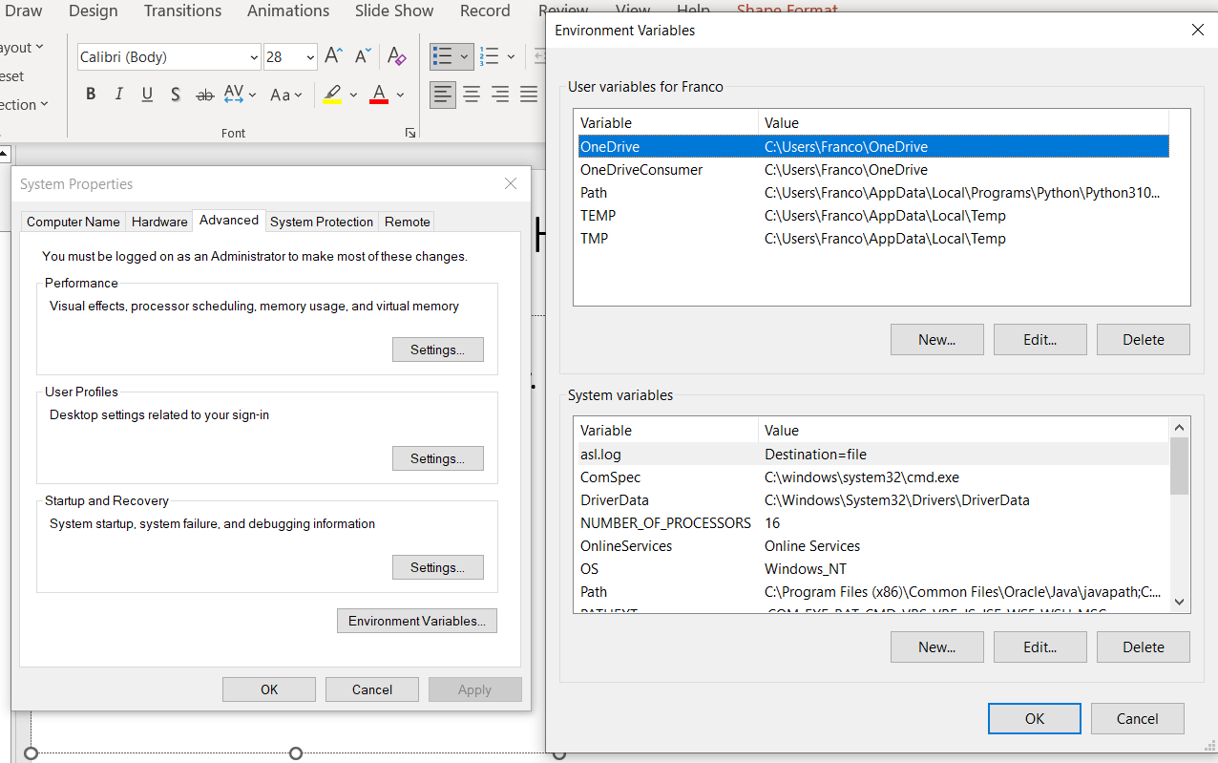
Add 4DPrinting to PATH
Search for “Advanced system settings” on windows search bar.
Press “Environmental Variables” and then “New” to create a new System Variable.

Slide 4
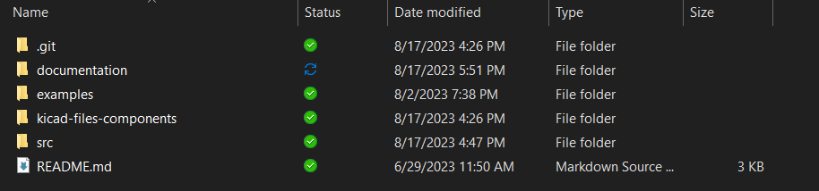
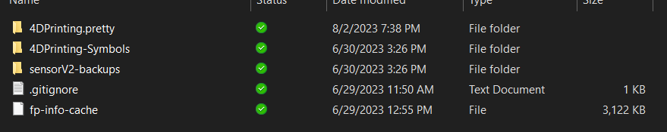
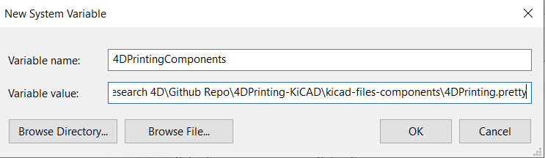
Add 4DPrinting to PATH
Create a new system variable “4DPrintingComponents” with the variable value being the path to the 4DPrinting.pretty folder located on the kicad-files-components subfolder of the Repository.
* Variable value should end in .pretty as shown in screenshot.

Slide 5
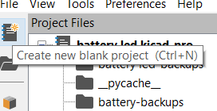
Open KiCAD
Open KiCAD app and press create new blank project on the sidebar or CTRL+N to start using KiCAD.
Open PCB Editor to get a view of the PCB Editor

Slide 6

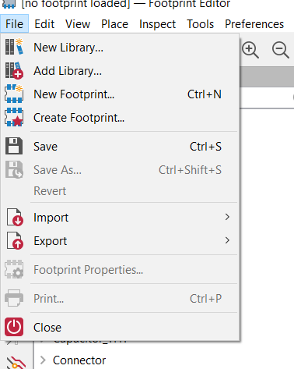
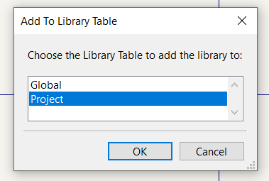
Install Custom Footprints
Open the PCB Editor and select the Footprint Editor in the Toolbar.
Add the 4DPrinting.pretty library (located inside the kicad-files-components folder) by navigating to “Add library” and selecting “Project” on the pop-up.

Slide 7
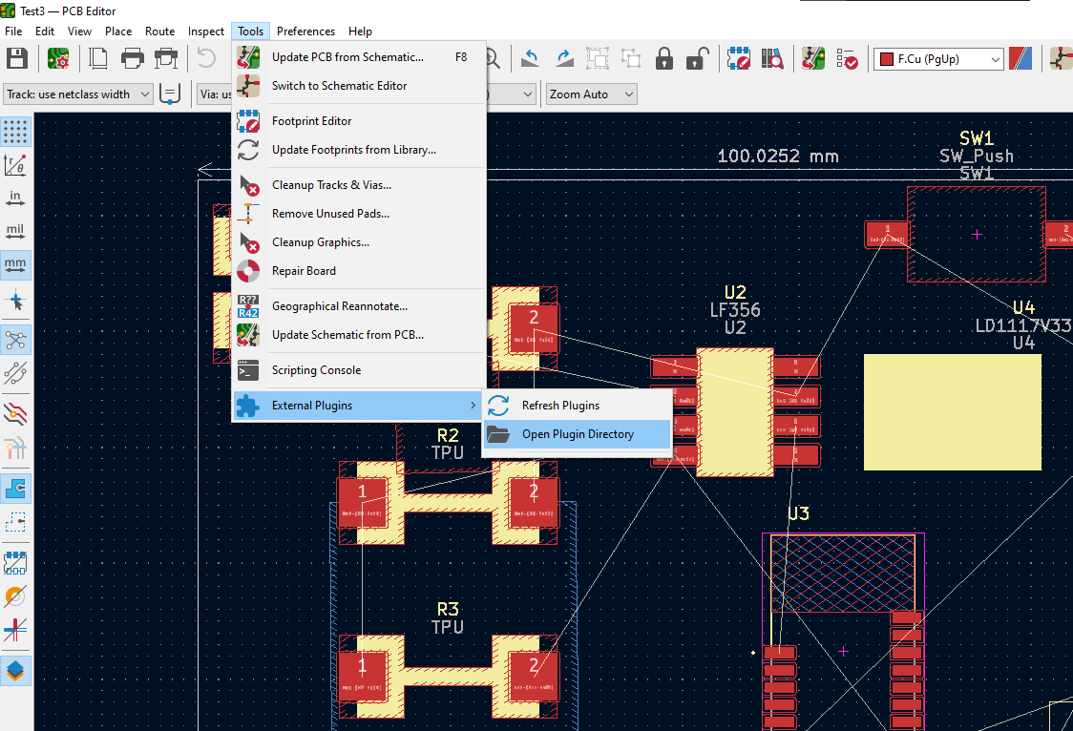
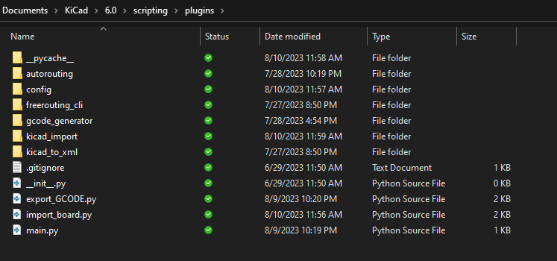
Install code in Plugins directory
After cloning or downloading github repository, paste the src folder into plugin directory.
Plugin directory can be accessed by opening the PCB Editor, navigate to Tools > External Plugins > Open Plugin Directory

Slide 8
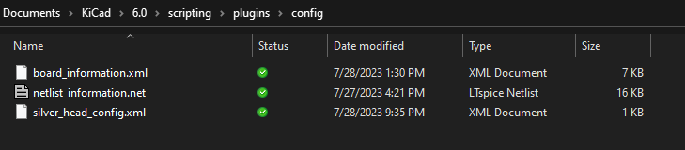
Input configuration files in the config folder
Config files (sample files provided):
board_information.xml: XML file with component, keepout and via information.
netlist_information.net: netlist compatible with Eeschema and with valid reference for components in the board_information.xml file
silver_head_config.xml: XML file containing header information for the silver extrusion head

Slide 9
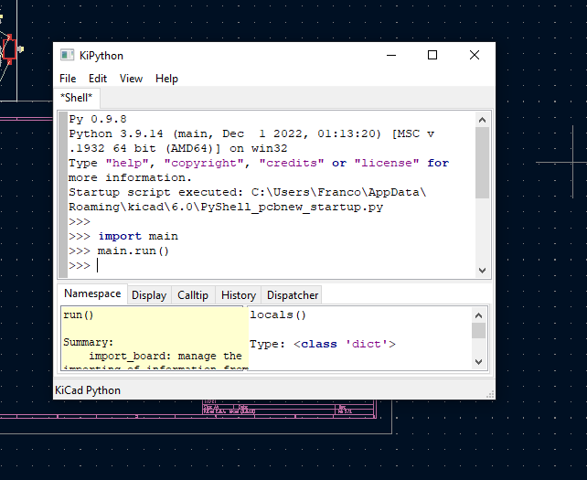
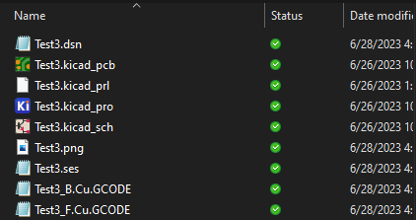
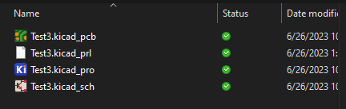
Run GCODE Generator
To autogenerate the double layer GCODE, navigate to the python scripting console (under Tools) and call the run() function from the main module.
The produced files should be on the KiCAD file’s root directory.

